Slide 1
Marketing and Retail Analytics
Project submitted by
Shilpa Pandey

Slide 2
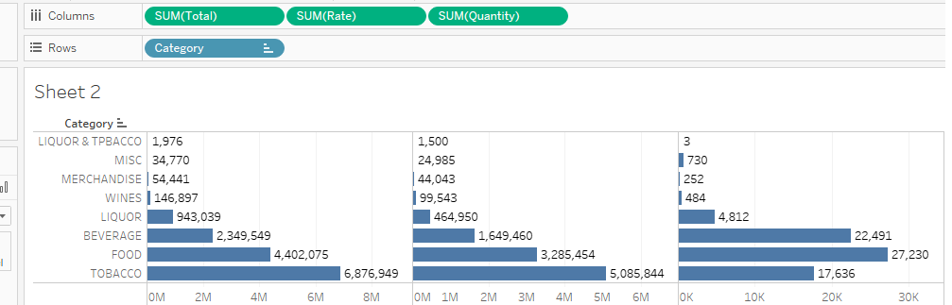
Exploratory Analysis of data
Data analysis as per total, quantity and rate

Slide 3
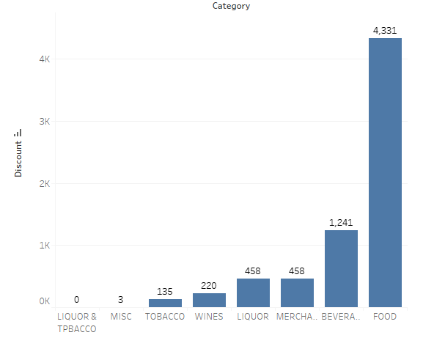
Exploratory Analysis of data
Discounts are highest on food category followed by beverages
Discounts are lowest for liquor and tobacco

Slide 4
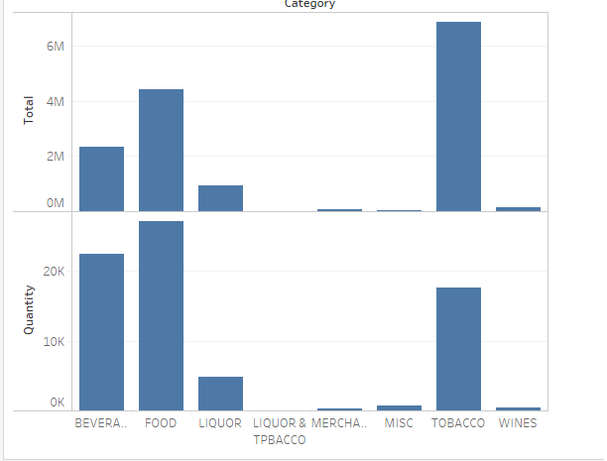
Exploratory Analysis of data
The consumption in terms of quantity for food category is high and lowest for liquor and tobacco
The consumption in terms of total price is highest for tobacco category and lowest for liquor and tobacco

Slide 5
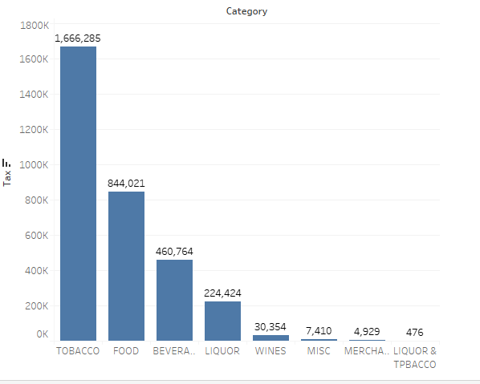
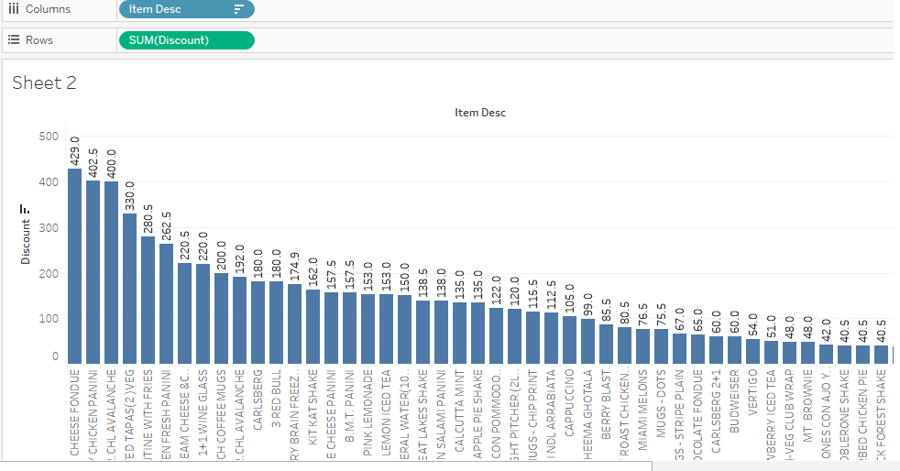
Exploratory Analysis of data
Discount is highest for cheese fondue.
Highly taxed category product is tobacco and least is liquor and tobacco

Slide 6
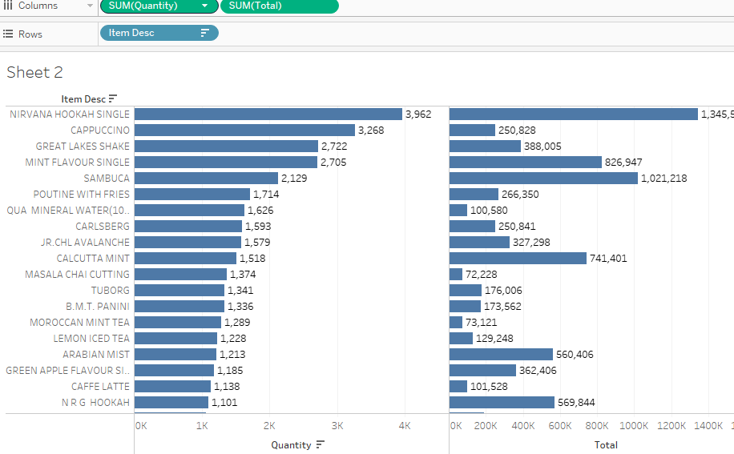
Exploratory Analysis of data
The item which is heavily consumed in terms of quantity , price and rate is Nirvana hookah single.

Slide 7
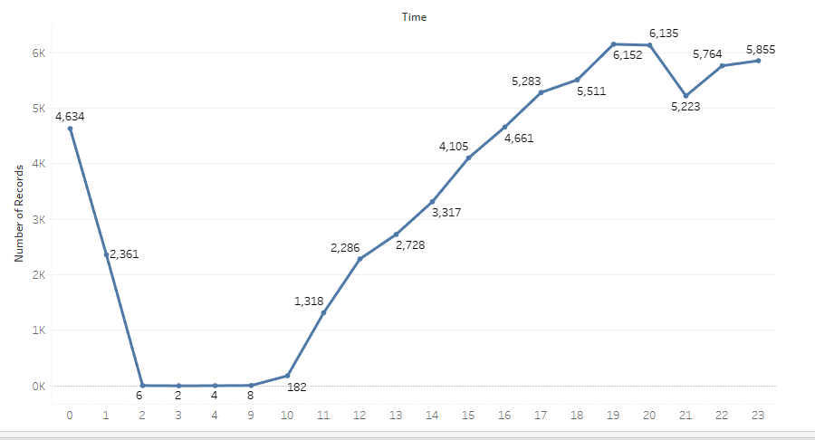
Customer behavior as per time of the day and recommendations
More purchase is between 9a.m. to 7 pm.
Also between 9 -11 pm.
Recommendations:
The major staffing has to be done during peak hours of the day where transaction is high

Slide 8
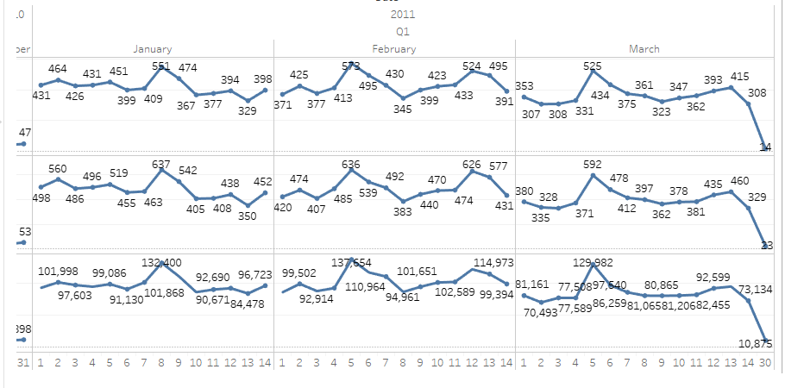
Customer behavior as per time of the day and recommendations in 2011
In 2011, there is no transaction after 15th for month jan and feb.
The highest transaction in jan and marc is on 5th and it is 8th for feb month.
The major decline is transaction for month march is after 13th
Recommendation: Major transaction is in 1st and 2nd staff so product and staff should be available more during those days

Slide 9
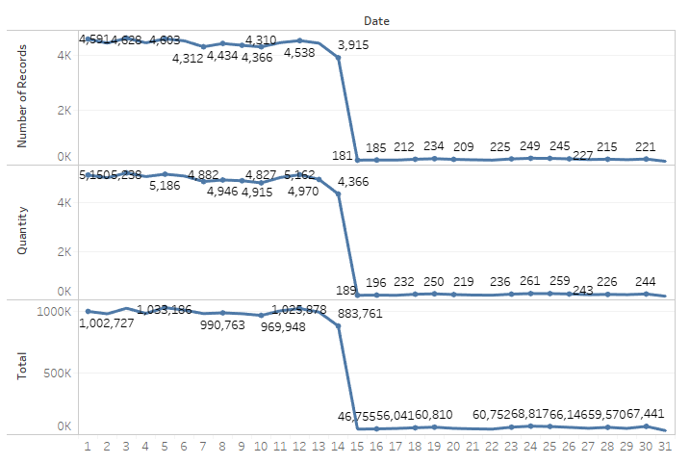
Customer behavior as per days of the months in 2010
Customer buys more products from start of the month to the mid of month. Also they purchase more and they purchase high price products.
From 13th or 14th of every month there is decline in purchase and it continues till end of month.
Recommendation: Major transaction is in 1st and 2nd staff so product and staff should be available more during those days

Slide 10
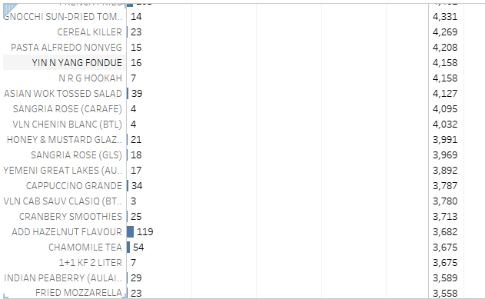
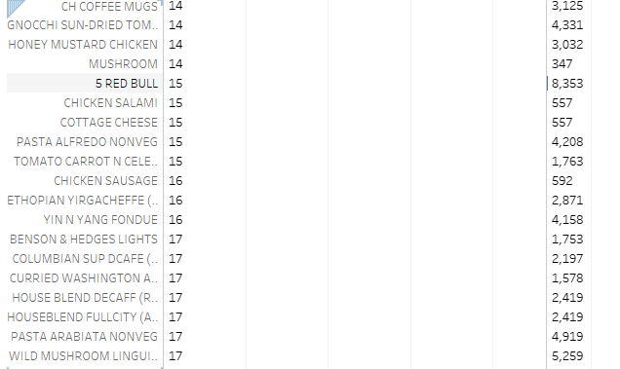
Items which can be removed from menu
Below items like ash tray, caponata etc are more in quantity and price is high but not consumed like cappuccino grande, cereal killer etc but highly bought can be removed
Below items are also high in quantity but rarely bought by customers can be removed

Slide 11
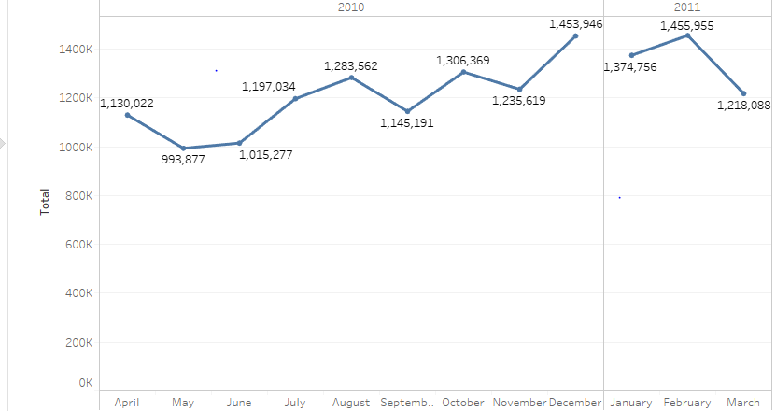
trends across months
Seasonlity monthy can not be seen as it has 2 yar data and 2010 has data from April to dec and 2011 has data from jan to Mar.
Highest purchase in 2010 in dec and lowest in may
Highest purchase in price in 2011 in feb and lowest in Mar.

Slide 12
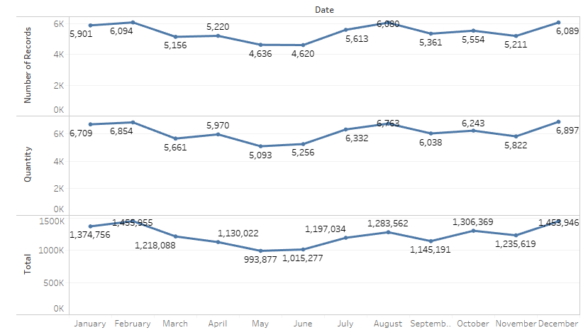
trends across months

Slide 13
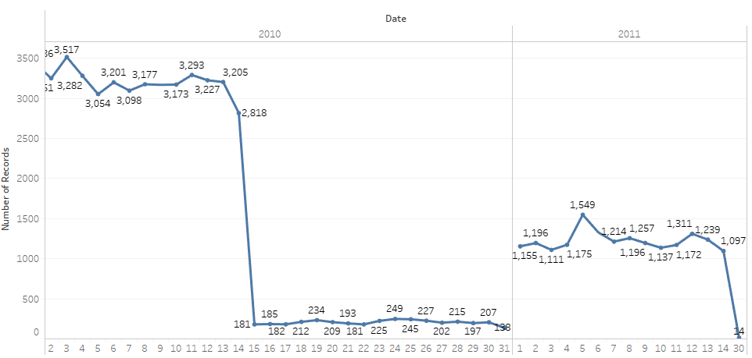
trends across months
Graph for year 2010 and 2011
There is decline in transaction after 13th and 14th in months of both year 2010 and 2011

Slide 14
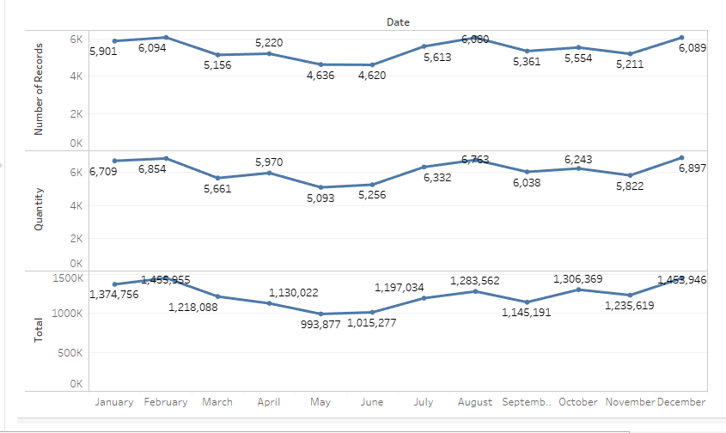
trends across months
No. of records are high in Aug and dec in 2010
No. of record is highest in feb in 2011
This data holds true for quantity and total as well

Slide 15
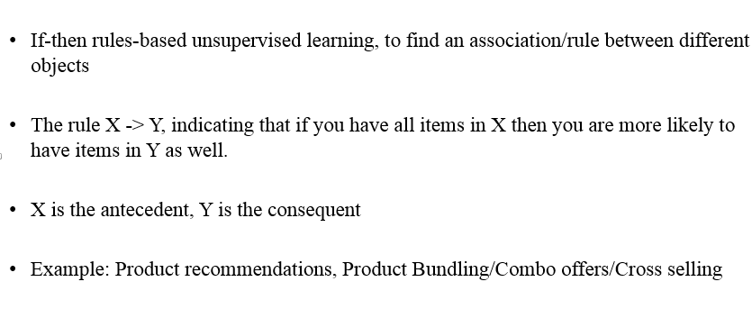
Market basket Analysis:
It works on association rules:

Slide 16
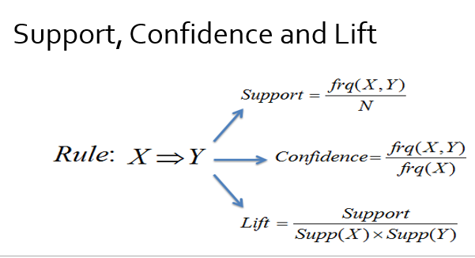
Deciding factor for market basket analysis:

Slide 17
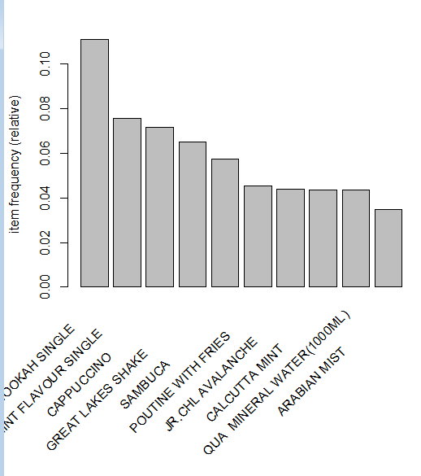
Relative item frequency

Slide 18
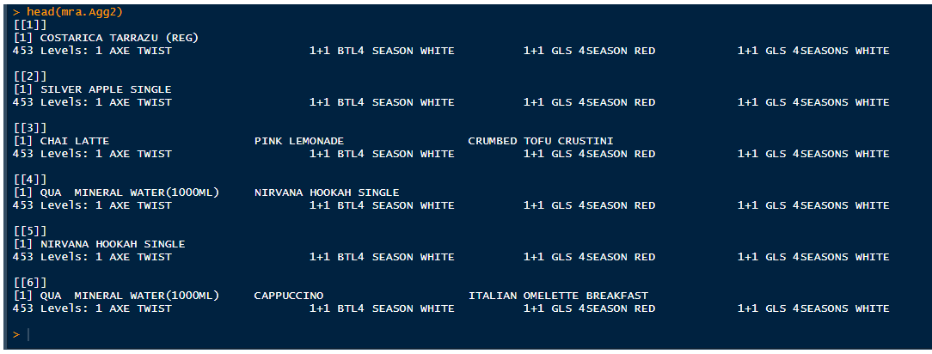
Transaction groups
The grouping of items is done using association rules (apriori function)

Slide 19
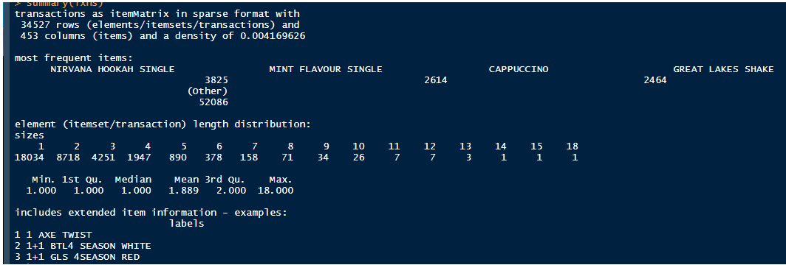
Best combo meals
Most frequent items are
Nirvana hookah
Mint flavor single
Cappuccino
Great lakes shake

Slide 20
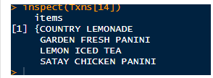
Grouping example
Example of association rule which gives transaction 14th combination of items.
The items include country lemonade, garden panini, lemon iced tea, satay chicken Panini.

Slide 21
Output with rules for items with given lift, confidence and support.

